Slide 1
Financial analysis of a new channel tunnel

Slide 2
Group member
Arpita Koundinya
Gaurav Rajan Korgaonkar
Hugo Leenhardt
Jingwen Liu
Qianli Ma

Slide 3
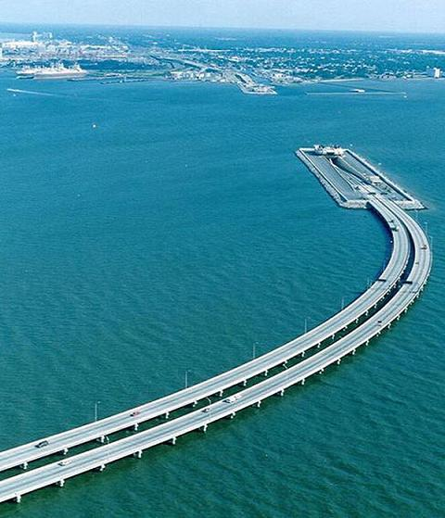
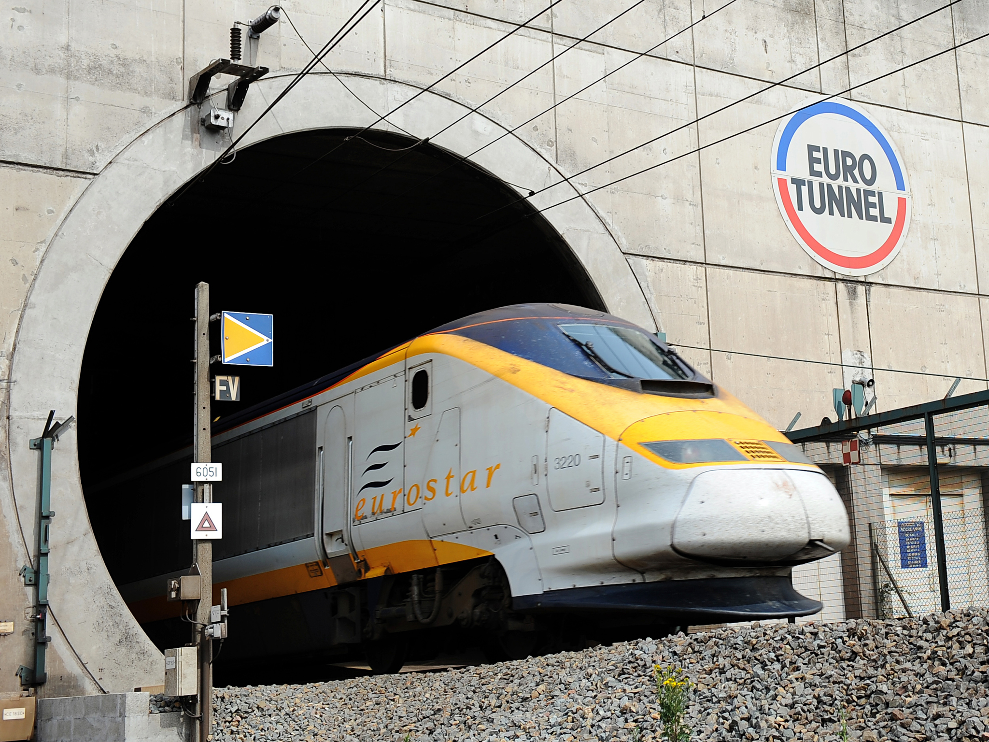
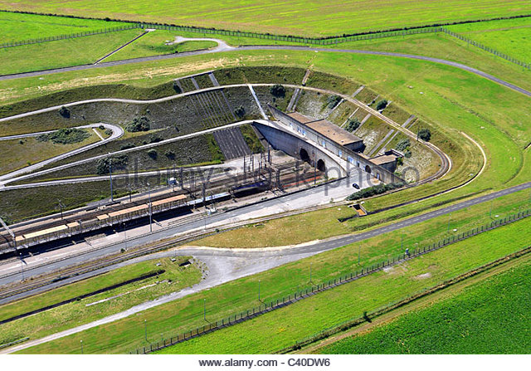
Background
The Channel tunnel (Eurotunnel) project ,undertaken to create a connection between England and France via an underground tunnel, represents one of the largest privately funded construction project undertaken.

Slide 4
Background
Why should start the project?
Busy transport & terrible weather
The trend of European integration
Who constructs and runs the project?
Channel Tunnel Group-France Manche (CTG-FM)
Contractor: Transmanche Link (TML)
What cause the financial Failure?
sign a contract with its partner
no incentives
Owner: Eurotunnel
no particular details in plan

Slide 5
Former Data Analysis
Expectation & Reality ：
 | expectation | reality
total investment （billion £） | 48 | 106
Initial rate of (travelers who cross the tunnel/traveler traveled in English channel) | 67% | 12%
Time limit of the project(year) | 5 | 7
The growth rate of the amount of travelers who crossed the tunnel | 3.53% | 4%

Slide 6
Former Data Analysis
Result
 | NPV | IRR
expectation | -2.691104849 | 25.37%
reality | -6.91992692 | 0.82%

Slide 7
Former Data Analysis
Sensitivity analysis—own investment level
parameter | -30% | -20% | -10% | 0 | 10% | 20% | 30%
Total investment | -1.3105 | -1.7707 | -2.2309 | -2.6911 | -3.1513 | -3.6115
Initial rate of (travelers who crossed the tunnel/travelers traveled in English Channel) | -3.2644 | -3.0733 | -2.8822 | -2.6911 | -2.5 | -2.3089
Growth rate of the amount of travelers who crossed the tunnel | -2.7107 | -2.7402 | -2.6976 | -2.6911 | -2.6846 | -2.6780
Call rate | -2.3609 | -2.4656 | -2.5756 | -2.6911 | -2.8122 | -2.9392
Debt asset ratio | -5.2200 | -4.6938 | -3.8563 | -2.6911 | -1.3096 | -0.1816 | --
M&O cost | -1.8312 | -2.1178 | -2.4045 | -2.6911 | -2.9777 | -3.2644 | -3.5510
Ticket Price | -3.2644 | -3.0733 | -2.8822 | -2.6911 | -2.5000 | -2.3089 | -2.1178

Slide 8
Former Data Analysis
Construction Period
Construction period | 4 | 5 | 6 | 7 | 8
NPV | -2.8901 | -2.6911 | -2.4902 | -2.1178 | -2.1178

Slide 9
Process of presentation

Slide 10
Process of presentation
Background & former analysis
Current income, loan interest and tax rate
Current initial cost and other assumption
Sensitivity analysis
Conclusions

Slide 11
Cash Inflow

Slide 12
Estimation
Data of Existing Tunnel
EOY | 1994 | 1995 | 1996 | 1997 | 1998 | 1999 | 2000 | 2001 | 2002 | 2003 | 2004 | 2005 | 2006 | 2007 | 2008 | 2009 | 2010 | 2011 | 2012 | 2013 | 2014
Passengers on Eurostar and Le Shuttle (In Millions) | 0.316 | 7.081 | 12.809 | 14.921 | 19.201 | 18.498 | 18.298 | 17.667 | 16.643 | 16.333 | 16.503 | 17.005 | 16.968 | 17.672 | 17.738 | 17.014 | 18.303 | 18.993 | 19.951 | 20.461 | 21.008
Through-train freight tonnes (In Millions) | 0.452 | 1.411 | 2.361 | 2.925 | 3.141 | 2.865 | 2.947 | 2.447 | 1.487 | 1.743 | 1.889 | 1.588 | 1.569 | 1.214 | 1.239 | 1.181 | 1.128 | 1.325 | 1.227 | 1.364 | 1.648
Total revenue ( Eurostar, Le Shuttle, freight tonnes ) in Billions | 0.031 | 0.340 | 0.607 | 0.714 | 0.894 | 0.855 | 0.850 | 0.805 | 0.725 | 0.723 | 0.736 | 0.744 | 0.742 | 0.755 | 0.759 | 0.728 | 0.777 | 0.813 | 0.847 | 0.873 | 0.906
Assumptions for pricing
EOY | 1 | 2 | 3 | 4 | 5 | 6 | 7 | 8 | 9 | 10 | 11 | 12 | 13 | 14 | 15 | 16 | 17 | 18 | 19 | 20 | 21
Ticket price per Passenger | 200 | 205 | 210 | 215 | 220 | 225 | 230 | 235 | 240 | 245 | 250 | 255 | 260 | 265 | 270 | 275 | 280 | 285 | 290 | 295 | 300
Frieght revenue per Frieght ton | 0.6 | 0.61 | 0.62 | 0.63 | 0.64 | 0.65 | 0.66 | 0.67 | 0.68 | 0.69 | 0.7 | 0.71 | 0.72 | 0.73 | 0.74 | 0.75 | 0.76 | 0.77 | 0.78 | 0.79 | 0.8
Estimate for New Tunnel
EOY | 1 | 2 | 3 | 4 | 5 | 6 | 7 | 8 | 9 | 10 | 11 | 12 | 13 | 14 | 15 | 16 | 17 | 18 | 19 | 20 | 21
Passengers on New tunnel (In Millions) | 5.00 | 10.00 | 12.00 | 15.00 | 16.00 | 16.00 | 17.00 | 17.00 | 18.00 | 18.00 | 19.00 | 19.00 | 20.00 | 21.00 | 21.00 | 22.00 | 22.00 | 22.00 | 23.00 | 23.00 | 24.00
Through-train freight tonnes (In Millions) | 2.00 | 2.00 | 2.00 | 2.00 | 2.50 | 2.50 | 2.50 | 2.50 | 3.00 | 3.00 | 3.00 | 3.00 | 3.00 | 3.50 | 3.50 | 3.50 | 3.50 | 3.20 | 4.00 | 4.00 | 4.00
Total revenue (New Tunnel, freight tonnes ) in Billions | 0.10 | 0.16 | 0.37 | 0.74 | 1.10 | 1.46 | 1.82 | 2.17 | 2.52 | 2.87 | 3.21 | 3.55 | 3.89 | 4.22 | 4.55 | 4.88 | 5.20 | 5.52 | 5.83 | 6.15 | 6.46

Slide 13
Assumptions based on analysis of existing tunnel cash flow.

Slide 14
Due to the lack of technological advancement in the 1990’s the amount of passengers had a low growth rate.
Now however, due to the advancement we see a better growth rate and hence a much better expected cash inflow.

Slide 15
Tax rates
By researching about the banks in the UK and France we found out that this amount of loan can not funded 100% and requires down payment.
Also, we found the loan interest rate and tax rates for this kind of loan amount.
Loan interest rate : 4%
MAAR : 8%
Income tax rate : 20%

Slide 16
Assumptions for Calculation

Slide 17
2. Initial Cost
Actual Cost * (1-Unecessary Cost Rate)
106 * 50% = 53
Materials *60% =31.8
Personnel*40% = 21.2
*169.62%*85% =42.89
*158.69% =35.96
Baseline
1998
Structure
Growth
2016

Slide 18
2. Initial Cost
Materials 50% =*(50%/60%) =35.75
Personnel 50% =*(50%/40%) =44.95
=(35.75+44.95) * 92% * 95%
70.53 billion £
Structure
Adjustment
Tech. & Mgmt.
Estimated Initial Cost

Slide 19
1. Annual Income

Slide 20
1. Other Parameters
Construction Time (years) | 5 | Loan payment period | 20
Initial cost (billion £) | 70.53 | loans (billion pounds) | 56.42
 |  | own fund (billion pounds) | 14.11
Debt rate | 80% | Loan interest rate | 4%
MARR | 8% | O&M | 30% * income
Depreciation | 39-year MACRS-GDS | Planning Horizon | 65 years
During construction period, loan will be received at the beginning of each year, and will be paid at the end of each year. Thus, there will be no cash flow at year 5.
…............
0 1 2 3 4 5 6 …...

Slide 21
Loan Payment Alternatives
1
ATIRR = 5.16%
ATNPV = -12.15B£
Equal end-of-period payments
2
ATIRR = 5.14%
ATNPV = -8.14B£
Interest each period & no principal payment until the end of the loan period
3
ATIRR = 5.12%
ATNPV = -12.88B£
Equal end-of-period principal + Interest each period on the unpaid balance
4
ATIRR = 6.02%
ATNPV = -4.06B£
Make no payment until the end of the loan period

Slide 22
Accumulative ATNPV Curve

Slide 23
Estimated Recovery Period (Rough)
（Assume that income will monotonically increase）
Alt | Years
1 | 422
2 | 421
3 | 236
4 | 119

Slide 24
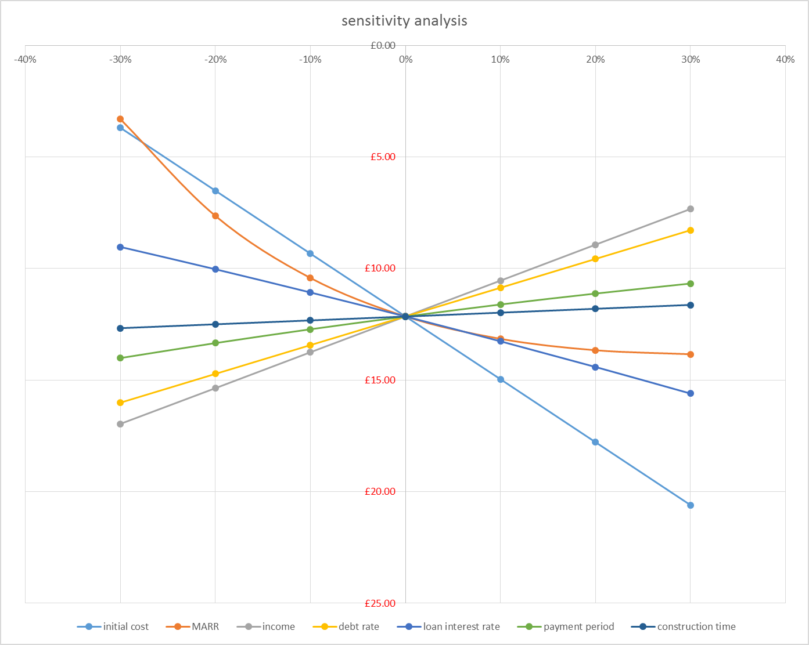
Sensitivity Analysis
Performed on the 4 payment alternatives
1st Alternative : Uniform annual payment
with both principal and interest
The NPV is the most sensitive towards
Initial cost (slope = -28.18)
Construction time and payment period is
The least sensitive

Slide 25
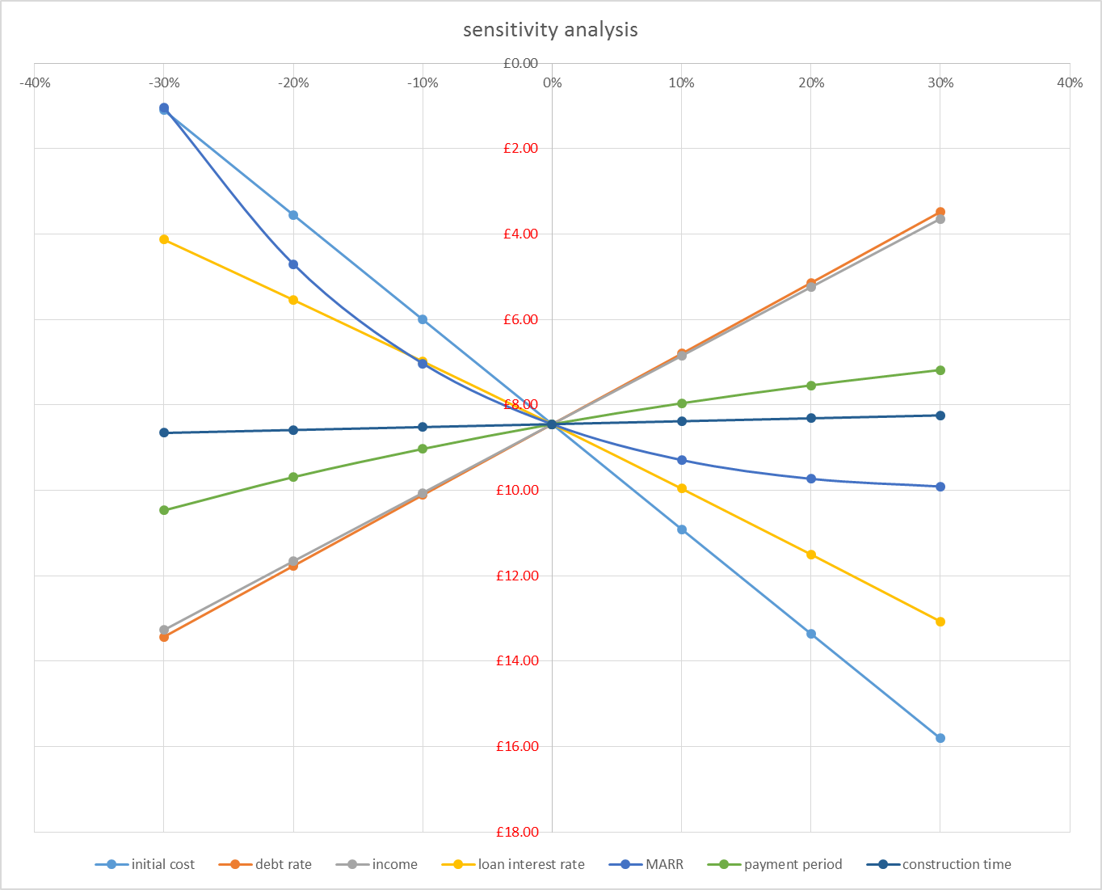
Sensitivity Analysis
2nd Alternative : Interest paid every
year and full principal at the end
NPV is the most sensitive when
Initial cost is changed ( slope = -24.5)
Construction time and payment
period is the least sensitive

Slide 26
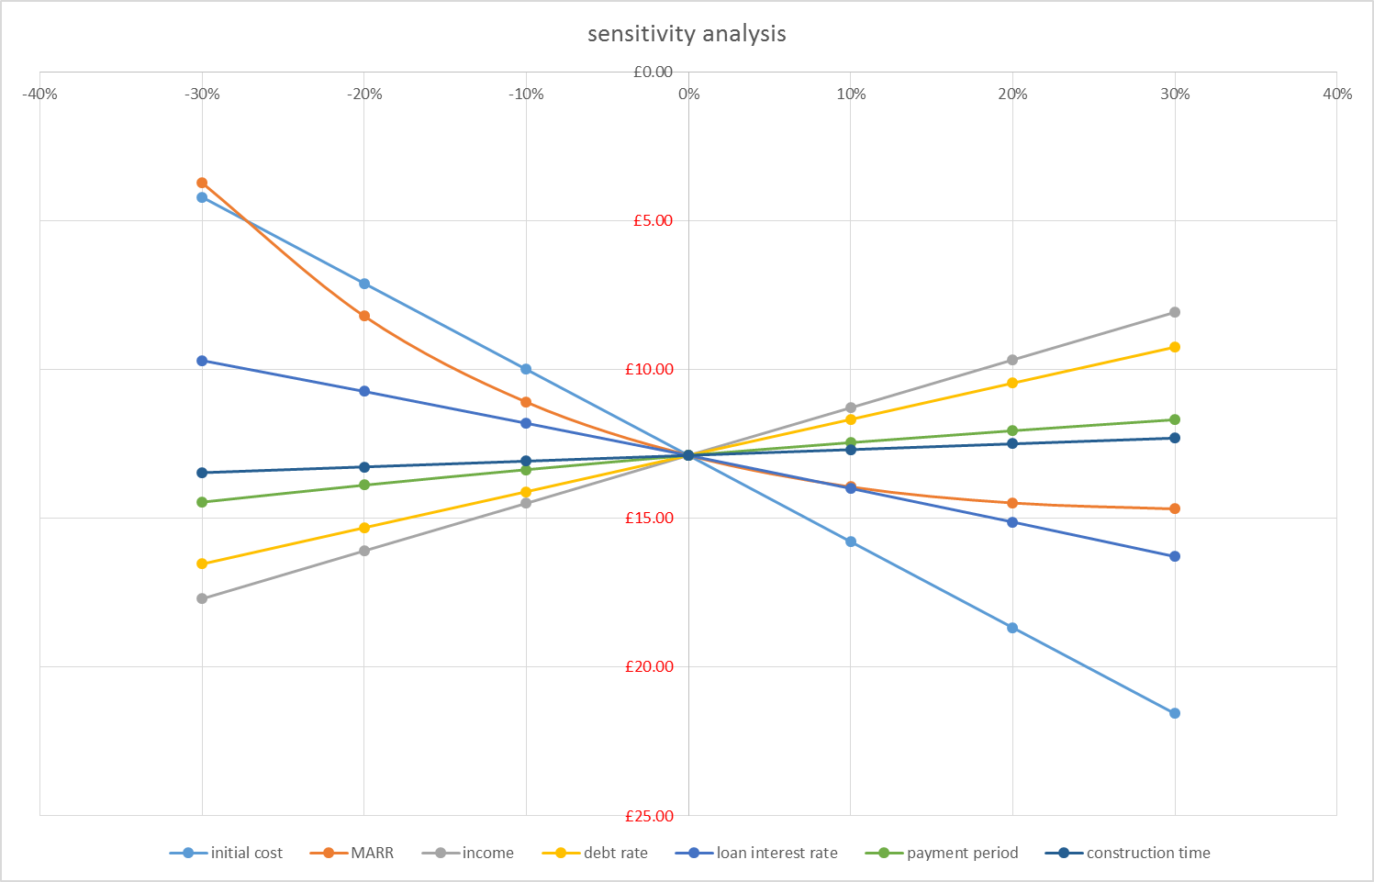
Sensitivity Analysis
3rd Alternative : Equal annual principal
and interest on unpaid principal
Initial cost is the most
sensitive (slope = -28.9)
Payment period and
Construction time is the least
sensitive.

Slide 27
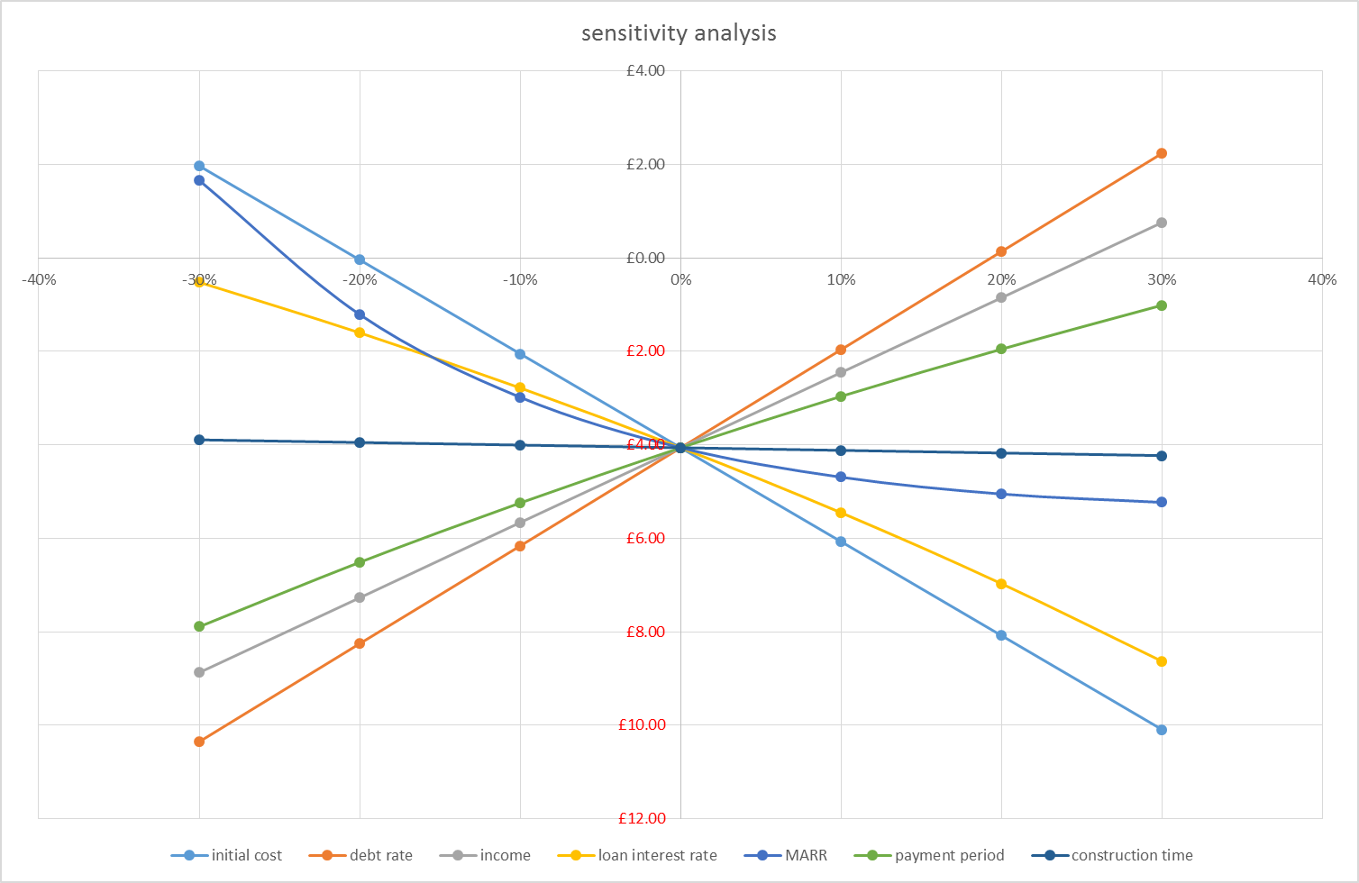
Sensitivity Analysis
4th Alternative : Lump sum at the end
of payment period
Debt rate is the most sensitive
(slope = 20.9)
Construction time is the least
sensitive

Slide 28
Conclusions

Slide 29
Results & Conclusion
All alternatives have PW < 0 => None should be chosen
Should we do nothing and keep the old tunnel?
”Do nothing” alternative was not considered
We only know the IRR of the previous tunnel => can’t be used.
So what should we recommend?
Alternative 4 is the most promising
Old tunnel cannot reach PW > 0 but alternative 4 can!
Initial cost and incomes are the most sensitive parameters
=>R&D should be considered to reduce initial cost or increase revenue

Slide 30
Thank you!
Any questions?

